Slide 1
Angular 2 routing

Slide 2
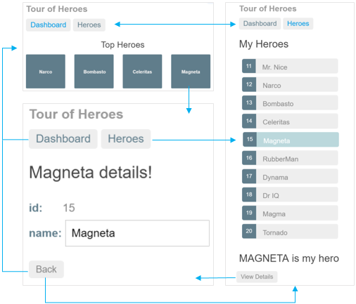
routing: components and page layout

Slide 3
Routes
Angular routes enables you to show different content depending on what route is chosen. A route is specified in the URL. Thus, the following URL's all point to the same AngularJS application, but each point to different routes:
http://localhost:3000/books
http://localhost:3000/albums
http://localhost:3000/games
http://localhost:3000/apps
books-> BookComponent
albums->AlbumsComponent
Games->GamesComponent
Apps->AppsComponent
route: loads mapped component in placehoder
in index.html
Advantages: better app structure; forward/backward in browser; app state can be shared
as URL (to search engine, social framework, favorites, messengers, etc…)

Slide 4
BASE HREF
The HTML <base> tag is used to specify a base URI, or URL, for relative links.
Most routing applications should add a <base> element to the index.html as the first child in the <head> tag to tell the router how to compose navigation URLs.
If the app folder is the application root, as it is for our sample application, set the href value exactly as shown here.
index.html:
<base href="/" />

Slide 5
Routing
@NgModule({ imports: [ BrowserModule, FormsModule, RouterModule.forRoot([ { path: 'hero/:id', component: HeroDetailComponent }, { path: 'crisis-center', component: CrisisListComponent }, { path: 'heroes', component: HeroListComponent, data: { title: 'Heroes List' } }, { path: '', component: HomeComponent }, { path: '**', component: PageNotFoundComponent } ]) ], <!-- Routed views go here --> <router-outlet></router-outlet>

Slide 6
Routing: defining in main app component
app.component.ts
import { RouterModule } from '@angular/router'; @Component({ selector: 'my-app', template: ` <nav> <a routerLink="/crisis-center" routerLinkActive="active">
Crisis Center</a> <a routerLink="/heroes" routerLinkActive="active">
Heroes</a> </nav> <router-outlet></router-outlet>` }) export class AppComponent {}

Slide 7
Routing: changing url programmatically
@Component({ selector: 'my-heroes', templateUrl: 'app/heroes.component.html', styleUrls: ['app/heroes.component.css’] }) export class HeroesComponent implements OnInit { heroes: Hero[]; selectedHero: Hero; constructor( private router: Router, private heroService: HeroService) {} getHeroes() { this.heroService.getHeroes().then(heroes => this.heroes = heroes); } ngOnInit() { this.getHeroes(); } onSelect(hero: Hero) { this.selectedHero = hero; } gotoDetail() {
this.router.navigate([’/hero', { id: this.selectedHero.id }]);
} }
goes to localhost:3000/hero/15

Slide 8

Routing: heroes template
<h2>My Heroes</h2> <ul class="heroes"> <li *ngFor=“let hero of heroes" [class.selected]="hero === selectedHero" (click)="onSelect(hero)"> <span class="badge">{{hero.id}}</span> {{hero.name}} </li> </ul>
<div *ngIf="selectedHero"> <h2> {{selectedHero.name | uppercase}} is my hero </h2> <button (click)="gotoDetail()">View Details</button> </div>

Slide 9
Routing: hero details component
app/hero-detail.component.html
@Component({ selector: 'my-hero-detail', templateUrl: 'app/hero-detail.component.html', }) export class HeroDetailComponent implements OnInit { hero: Hero; constructor(private heroService: HeroService, private route: ActivatedRoute, private location: Location) { } goBack(): void { this.location.back(); }
ngOnInit(): void { this.route.params .switchMap((params: Params) =>
this.heroService.getHero(+params['id'])) .subscribe(hero => this.hero = hero); } }
Notes:
Note: here no unsubscribe is necessary, because component knows that it should clear up the route hooks.

Slide 10
Routing: hero details template
hero-detail.component.html
<div *ngIf="hero"> <h2>{{hero.name}} details!</h2> <div> <label>id: </label>{{hero.id}}</div> <div> <label>name: </label> <input [(ngModel)]="hero.name" placeholder="name" /> </div> <button (click)="goBack()">Back</button> </div>

Slide 11
candeactivate
app/services/CanDeactivateTeam.ts
@Injectable() class CanDeactivateTeam implements CanDeactivate<TeamComponent> { constructor(private permissions: Permissions, private currentUser: UserToken) {}
canDeactivate(component: TeamComponent, route: ActivatedRouteSnapshot, state: RouterStateSnapshot): Observable<boolean>|Promise<boolean>|boolean { return this.permissions.canDeactivate(this.currentUser, route.params.id); } }
app/AppModule.ts
@NgModule({ imports: [ RouterModule.forRoot([ { path: 'team/:id’, component: TeamComponent, canDeactivate: ['canDeactivateTeam'] }]) ],

Slide 12
Redirecting routes
The preferred solution is to add a redirect route that translates the initial relative URL ('') to the desired default path (/heroes). The browser address bar shows .../heroes as if you'd navigated there directly.
const appRoutes: Routes = [ { path: 'crisis-center', component: CrisisListComponent }, { path: 'heroes', component: HeroListComponent }, { path: '', redirectTo: '/heroes', pathMatch: 'full' }, { path: '**', component: PageNotFoundComponent } ];

Slide 13
Hash strategy
Here's the Crisis Center URL in this "HTML 5 pushState" style:
localhost:3002/crisis-center/
Here's a "hash URL" that routes to the Crisis Center
localhost:3002/src/#/crisis-center/
The router supports both styles with two LocationStrategy providers:
PathLocationStrategy - the default "HTML 5 pushState" style.
HashLocationStrategy - the "hash URL" style.
You can go old-school with the HashLocationStrategy by providing the useHash: true in an object as the second argument of the RouterModule.forRoot in the AppModule:
RouterModule.forRoot(routes, { useHash: true }) // .../#/crisis-center/

